Slide 1

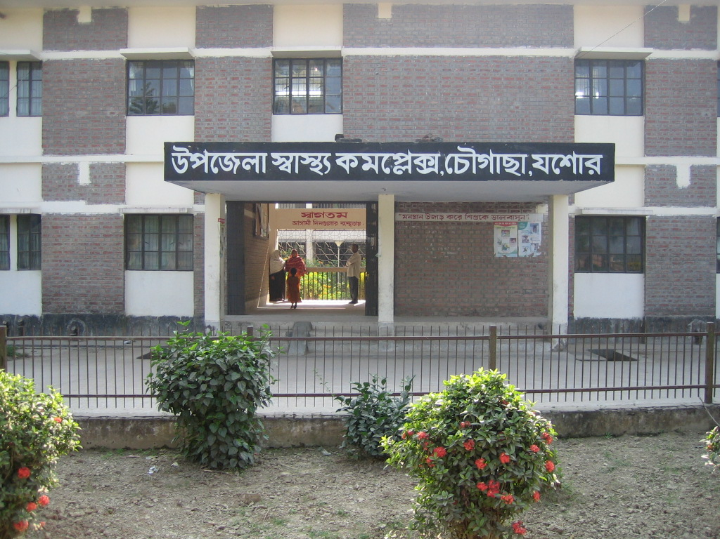
UPAZILA HEALTH COMPLEX
Chowgacha, Jessore.
Dr. Emdadul Haque
Jn. Consultant (Obst & Gynae)

Slide 2
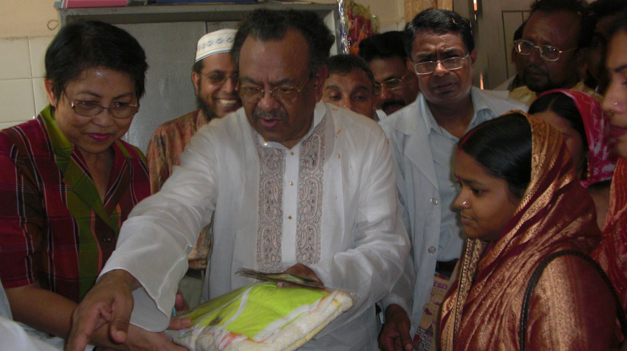
Hon’ble Health Minister for Health & Family Welfare with WHO Representative at Chowgacha handing over money and gift of voucher scheme of DSF

Slide 3
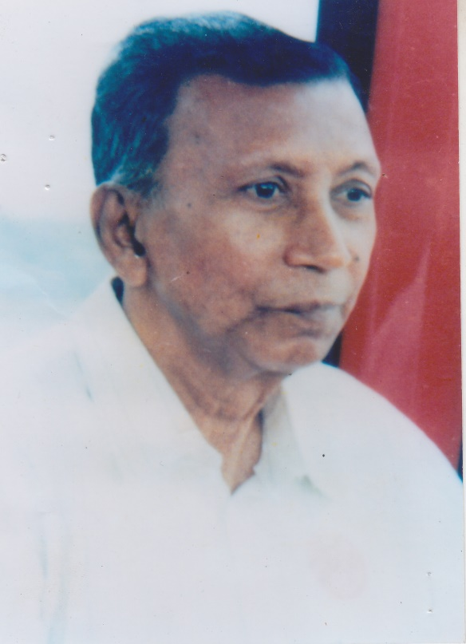
“During the marriage of your daughter you should mansion a precondition in Kabinnama that your daughter should delivered her baby in Hospital”
Prof. Dr. Moklechur Rahman

Slide 4
Basic National Health Indicators
IMR (per thousand LB) 52
MMR (per thousand LB) 3.2
NMR (per thousand LB) 37
Under 5 MR (per thousand LB) 65
Crude birth rate (per thousand pop.) 20.9
Crude death rate (per thousand pop.) 6.2
Population growth rate (%) 1.4
Total fertility rate (birth per women) 2.7
Life expectancy at birth Male 65.4 yrs
Female 67.9 yrs
Source: Health Bulletin 2009, MIS,DGHS

Slide 5
MDG 4 and 5 Achieved in
Jhenaidah
Per 1000 live Birth Jhenaidah MDG Target National
MMR: .60 1.47 1.94
(MDG 5 Achieved)
IMR: 32 31 38
(MDG 4 near to target)
<5 MR: 42 50 46
(MDG 4 Achieved)

Slide 6
A Sub-district level Women-Friendly Hospital with a Vision …
Motivation of doctors
Maximum utilization of Govt.
resources with
honesty and sincerity
Integrated approach of
Administration, Community
Leaders & Health
Management
Providing Effective and
prompt services
through improved
management system
Show respect to the
patients

Slide 7
Health Profile of Chowgacha Upazila- 2010
Total population : 245730
Total Fertile Couples : 52268
Total Pregnant : 5208
Total Delivery : 4427
Total Live birth : 4312
Total death : 932
Total Maternal death : 02
Health Man power
a. Doctor : 19 ( 11 + 8)
b. Nurse : 14+4
c. HA : 25
d. SBA : 13( 3HA+10 FWA )
e. Volunteer, Security guard & cleaner: 36
9. Health Institutions
a. Health Complex : 01
b. H & FWC : 11 (RD- 4 + FWC– 7 )
c. Community clinic : 23
d. Non- Govt. Clinic : 03

Slide 8
10. Mother Taken-ANC : 143% ( 1st Visit)
11. Hospital Delivery Rate : 84.8% (3755)
12. Total C. Section rate : 21.7% (962)
13. No. of Hospital bed : 50
14. Bed Occupancy Rate : 200%
15. Maternal Mortality Ratio : 42 / 100000 live Birth
16. Neonatal Mortality Rate : 16.7 / 1000 live birth
17. Infant Mortality Rate : 20.6 /1000 live birth
18. Under-5 Mortality Rate : 22.7 /1000 live birth

Slide 9
Background History of MCH services of Chowgacha Health Complex, Jessore
To reduce Maternal and Child Mortality and Mobility and to ensure
the quality services to the mother and child, UHFPO opened 4
special activities headed by medical officers in Feb. 1996. And
from January 1997 to 2000 JICA helped us by Frontline MCH
Program to implement the program by giving technical and
logistic supports.
<4 Special activities>
ANC-Corner – leaded by female Medical Officer for pregnant mother for effective ANC services who receive TT immunization in the Health Complex
Basic EOC service by a Gyne & Obs. trained MO
Under 5 corner for under 5 children for their nutritional assessment and treatment by RMO.
Monthly birth and death record by specially developed format by health assistant throughout the Upazilla to asses the progress of maternal and child health status by health indicators supervised by UH&FPO

Slide 10
Contd.
From Dec. 1999 Reproductive Health Department of DGHS and UNICEF gave logistic supports and human resources development (like medical officer trained in anesthesia).
Form November 2000 started Comprehensive EOC program
In 2004, 2005, 2006, 2007 , 2008 & 2009 the UHC was awarded by the Bangladesh Government and UNICEF for best performance on EOC Service.
From August 2006 Safe Blood Transfusion unit established with the aid of UNICEF.
From April 2007 Demand Side Financing (DSF) program started.
Women friendly Hospital declared in 2008.
Hospital is declared as model health complex on 20 June 2008 and upgraded to 50 bedded hospital by Secretary of Ministry of Health & family welfare.
Chowgacha health complex Model is replicable through out the country. Declared by Dr. Margaret Chan, D.G. WHO on 8th March 2010.

Slide 11
Upazila Health Complex
CHOWGACHA , JESSORE.
Emergency & Out door Service 2005 to 2010
Sl No | Year | Emergency Patients | Out door Service
01 | 2005 | 4308 | 80591
02 | 2006 | 4091 | 84301
03 | 2007 | 4287 | 105963
04 | 2008 | 4275 | 120117
05 | 2009 | 5144 | 126369
06 | 2010 | 7071 | 95958

Slide 12
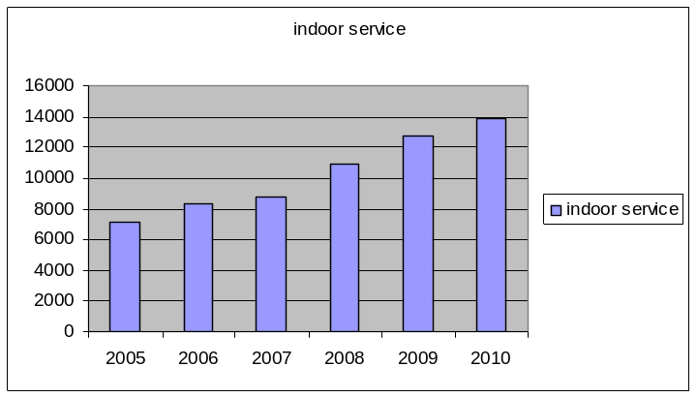
Upazila Health Complex
CHOWGACHA , JESSORE.
Indoor Service 2005 to 2010
Sl No | Year | indoor Service | No of Bed | Bed occupancy rate
01 | 2005 | 7126 | 31 | 158.0%
02 | 2006 | 8355 | 31 | 182.0%
03 | 2007 | 8743 | 31 | 201.0%
04 | 2008 | 10944 | 50 | 199.0%
05 | 2009 | 12717 | 50 | 185.0%
06 | 2010 | 13887 | 50 | 199.7%

Slide 13
Upazila Health Complex
CHOWGACHA , JESSORE.
EOC ACTVITIES: 1997 - 2010
Sl No | Indicator | 1997 | 2000 | 2001 | 2002 | 2003 | 2004 | 2005 | 2006 | 2007 | 2008 | 2009 | 2010
1 | ANC 1st Visit | 1228 | 2861 | 3509 | 3932 | 4484 | 4898 | 4993 | 5944 | 7292 | 8263 | 7499 | 7427
2 | ANC 2nd Visit | 580 | 1710 | 2172 | 2718 | 3022 | 3620 | 3600 | 4203 | 4998 | 6237 | 6090 | 6157-
3 | ANC 3rd Visit | 561 | 823 | 1032 | 1208 | 1515 | 1717 | 2071 | 2190 | 2716 | 3453 | 5558 | 4566
4 | PNC | - | 264 | - | - | 445 | 636 | 698 | 1079 | 614 | 2012 | 3120 | 3079
5 | Total delivery | 151 | 312 | 421 | 422 | 661 | 1030 | 1293 | 1518 | 1899 | 2682 | 3489 | 3755
6 | Caesarian Section | - | 03 | 11 | 26 | 36 | 184 | 310 | 363 | 473 | 567 | 842 | 962
7 | Maternal Death in Health Complex | - | 1 | 1 | 1 | 0 | 2 | 3 | 1 | 1 | 03 | 0 | 0
8 | Still Birth | 16 | 09 | 14 | 25 | 29 | 34 | 49 | 45 | 57 | 65 | 69 | 74
9 | Admission in Labor Ward | 214 | 773 | 769 | 910 | 1145 | 1649 | 2013 | 2397 | 2807 | 4031 | 4978 | 5329
10 | Refer to General Hospital | 44 | 101 | 102 | 167 | 89 | 54 | 76 | 115 | 152 | 207 | 124 | 100
11 | Blood Transfusion (bag ) | 15 | 19 | 38 | 39 | 40 | 136 | 173 | 144 | 106 | 198 | 165 | 137

Slide 14
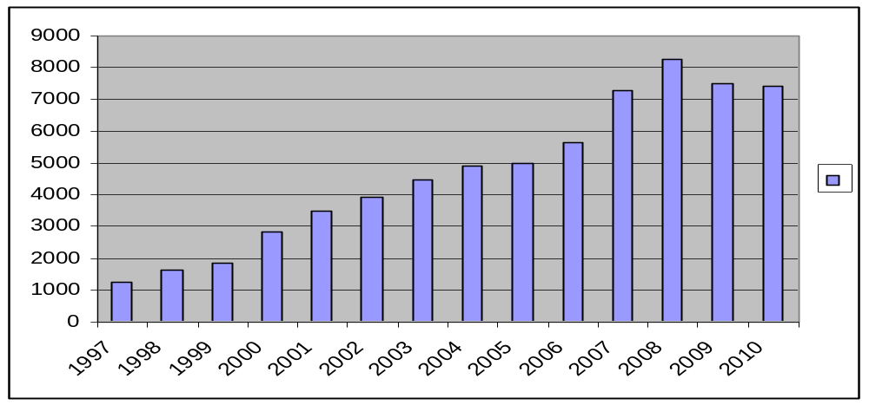
Upazila Health Complex
CHOWGACHA , JESSORE.
EOC Activities : 1997- 2010 (ANC First Visit)
8263
7292
7499
7427
5644
4898
4993
4484
3932
3509
2861
1631
1851
1228

Slide 15
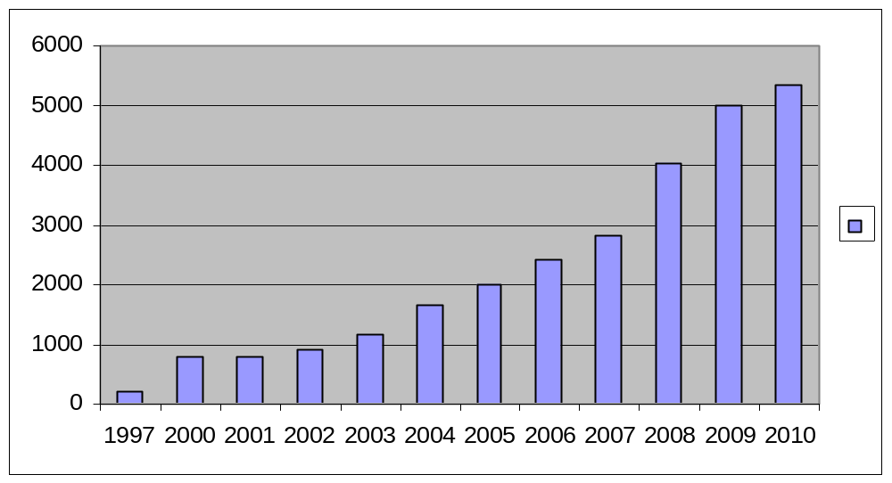
Upazila Health Complex
CHOWGACHA , JESSORE.
EOC Activities : 1997- 2010 (Admission in labour ward
5329
4978
4031
2807
2397
2013
1649
1145
773
769
910
214

Slide 16
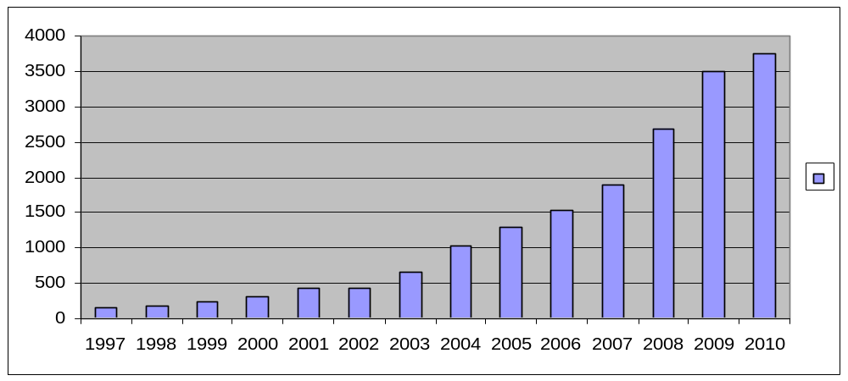
Upazila Health Complex
CHOWGACHA , JESSORE.
EOC Activities : 1997- 2010 (Hospital Delivery )
3755
3489
2682
1899
1518
1293
1030
661
312
421
422
151
182
228

Slide 17
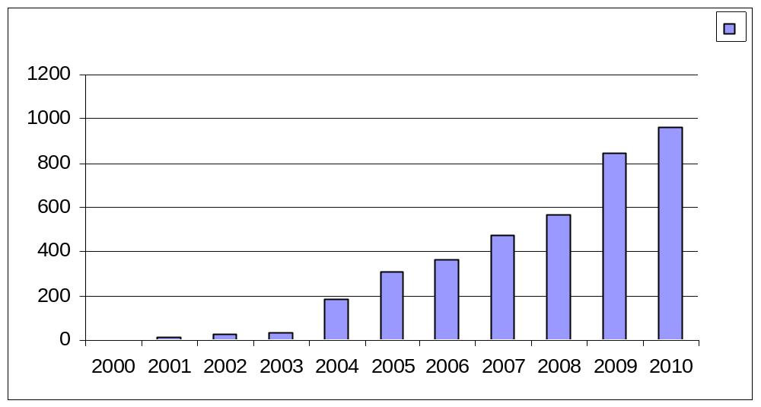
Upazila Health Complex
CHOWGACHA , JESSORE.
EOC Activities : 2000 - 2010 (Caesarian Section)
962
842
567
473
363
310
184
3
11
26
36

Slide 18
Upazila Health Complex
CHOWGACHA , JESSORE.
DSF Progress : January to December 2010
TOTAL PREGNANT MOTHER( ESTIMATED ) : 5208
ESTIMATED POOR PREGNANT MOTHER : 2604
DSF Yearly Target : 2344
Total Delivery Target : 2227
Monthly Target : 195
Total Voucher Distribution : 2234
1st. ANC : 2205(94.6%)
2nd. ANC : 2144(91.5%)
3rd. ANC : 1695(72.3%)
Total Delivery ( Hospital NVD +Field Del. by SBA) : 1358 + 67
C – SECTION : 355 (15.7%)
PNC (Hospital + Field) : 1672+24 (77%)
Hospital delivery rate : 77 %
Safe delivery rate : 80 %
% OF POOR PREGNANT MOTHER COVERED : 95.3%
( Against yearly target )
One DSF Maternal Health death in 2010

Slide 19
Upazila Health Complex
CHOWGACHA , JESSORE.
Progress Of EOC Activities based on UN Process Indicators
SL No | Indicators | 2005 | 2006 | 2007 | 2008 | 2009 | 2010 | Target of UN Process
01 | Total Pregnancy | 5270 | 5365 | 5489 | 5793 | 5595 | 5208 | -
02 | Total Hospital delivery | 1293 | 1518 | 1899 | 2682 | 3489 | 3755 | -
03 | Total Caesarian section | 310 | 363 | 473 | 567 | 842 | 962 | -
04 | Maternal death in health Complex. | 03 | 01 | 01 | 3 | 0 | 0 | -
05 | % of birth in health Complex. | 26.5% | 32.3% | 38.1% | 52.4% | 72% | 84.8 | >15%
06 | Met-need for EmOC | 92.1% | 113% | 107% | 175 % | 232% | 267% | 100%
07 | Caesarian section of all births | 6.3% | 7.4% | 9.7% | 11% | 17.3%* | 21.7 | 5-15%
08 | Case Fatality Rate | 0.44% | 0.12% | .13% | 0.20% | 0.0% | .0% | <01%
* NB: Among the total delivery of Chowgacha Upazilla, the CS rate is 14% but CS 7.7 % is
increased due to complicated delivery from outside this upazilla.

Slide 20
Upazila Health Complex
CHOWGACHA , JESSORE.
Comparative Data of Delivery of best performing EOC center of Khulna Division in 2009
SL No | Name of institute | NVD | Vacuum Del. | V. Breech | C. Section | Total
01. | Chowgacha UHC | 2552 | 58 | 37 | 842 | 3489
02. | Ad-din Hospital Jessore. | 1113 | 0 | 0 | 1645 | 2758
03. | KMCH Khulna | 1387 | 56 | 5 | 928 | 2376
04. | 250 bed Hospital, Khustia | 1435 | 0 | 26 | 881 | 2342
05. | 250 bed Hospital, Jessore | 871 | 0 | 0 | 1278 | 2149
06. | Fatima Hospital Jessore. | 586 | 0 | 7 | 1096 | 1689

Slide 21


Upazila Health Complex
CHOWGACHA , JESSORE.
Under 5 Service (2009-2010).
S. No | Year | Admission in indoor |  |  |  |  | Outdoor
 |  | Male | Female | Total | Death | Refer
1 | 2009 | 1416 | 855 | 2271 | 20 | 55 | 24776
2 | 2010 | 1733 | 1124 | 2897 | 8 | 66 | 20919

Slide 22
Upazila Health Complex
CHOWGACHA , JESSORE.
How maternal mortality ratio and neonatal death rate is reduced?
A. Intervention to reduction of maternal death.
1.Hospital ANC service
2.Health education.
3.Hospital delivery service.
4.Round o clock EmOC service
5.Hospital PNC service
6.Prevention of PPH by using of oxitocic and misoprostol.
7.Running blood bank service/Blood bank service
8.Use of Mag.sulph in severe PIH and eclampsia.
9.Prevention of infection by shoe free environment and use of preventive antibiotic and
maintainance of sterility.
10.DSF program for the PPM
11.Effective family planning
12.Community participation in every service
13.Positive attitude of the service providers.
14.Referral service
15.Women friendly environment.
16.Maternal death review.

Slide 23
Upazila Health Complex
CHOWGACHA , JESSORE.
B.Intervention of reduction of perinatal and neonatal death:
1.Hospital antinatal service
2.Health education about nutrition during prgnancy to reduce the
low birth wt.
3.Iron and folic acid supports during pregnancy
4.Hospital delivery service
5.Management of birth asphyxia
6.Round o clock EmOC service
7.Hospital PNC service
8.Early breast feeding
9.Seperate pediatric ward service specially for the management of
ARI and diarrhea
10.DSF program.
11.Under 5 –corner/IMCI corner service
12.EPI service
13.Referal service
14. Death review

Slide 24
Upazila Health Complex
CHOWGACHA , JESSORE.
EOC ACTVITIES : ( Vision By The Year 2010)
SL No | Indicator | Achived |  |  |  |  |  | Target
 |  | 1997 | 2000 | 2005 | 2008 | 2009 | 2010 | 2010
01 | ANC 1st Visit % | 24.6 | 59 | 94.7 | 143.0 | 147 | 142.6 | 100
02 | ANC 2nd Visit % | 11.6 | 33.4 | 68 | 108 | 119 | 118.2 | 100
03 | ANC 3rd Visit % | 9.2 | 22 | 39 | 59.6 | 109 | 87.6 | 100
04 | PNC % | - | 5.5 | 13.5 | 39.3 | 64 | 59.1 | 80
60 | Hospital Delivery Rate% | 3.4 | 6.4 | 26.5 | 52.4 | 72 | 84.4 | 90
06 | Caesarian Section Rate% | 0 | 0.07 | 6.3 | 11.0 | 17.3 | 21.7 | 15
07 | Maternal Mortality Ratio / 100000 Live birth | 210 | 168 | 160 | 120 | 42 | 42 | 42
08 | Neonatal Death Rate / 1000 live birth | 42.4 | - | 21.5 | 16.5 | 19.3 | 16.7 | 15

Slide 25
Upazila Health Complex
CHOWGACHA , JESSORE.
Millennium Development Goals ( MDGs ) : Health ( MDGs + PRSP )
SL No | Indicator | Status |  |  |  |  |  | Target
 |  | 2007 | 2006 | 2007 | 2008 | 2009 | 2010 | 2006 | 2015
 |  | National | Chowgacha | Chowgacha | Chowgacha | Chowgacha | Chowgacha
A. Child Health
1 | NMR/1000 Live birth | 37(07) | 19.5 | 21.5 | 16.5 | 19.3 | 16.7 | 32 | -
2 | IMR/1000 Live birth | 52 (2007) | 29.6 | 29.2 | 23.2 | 23.9 | 20.6 | 48 | 31
3 | U5MR/1000 Live birth | 62 (2007) | 41.0 | 33.3 | 27.6 | 25.8 | 22.7 | 70 | 50
B. Reproductive health
1 | ANC Coverage( 3rd visit) | 52 (2007) | 41% | 49.6% | 59.6 % | 108% | 87.6 | 60% (1st) | -
2 | PNC Coverage | 15% (2007) | 20.1% | 11.2% | 39.3 % | 64% | 59.1 | 30%
3 | EOC Risk Coverage( MN ) | - | 113% | 107% | 175 % | 232% | 267 | 40% | 100%
4 | Ensure EOC to all women | - | - | - | - | - | - | - | -

Slide 26
SL No | Indicator | Status |  |  |  |  |  | Target
 |  | 2007 | 2006 | 2007 | 2008 | 2009 | 2010 | 2006 | 2015
 |  | National | Chowgacha | Chowgacha | Chowgacha | Chowgacha | Chowgacha
5 | Skill attendant at birth | 18% (2007) | 32.3% | 38.1% | 52.4% | 72% | 84.8 | 25% | 50%
6 | MMR/100000 live birth | 290 (2007) | 150 | 160 | 119 | 42 | 42 | 275 | 147
7 | CPR | 55.1% (2003) | 68.7% | 66.6% | 66.7% | 67% | 69% | 63% | -
8 | TFR | 3.2 (2003) | - | - | 2.1 | - | - | 2.8 | -
9 | Increase male parti in conuse | - | - | - | - | - | - | - | -
10 | Women life expectancy Rate | 68yrs (2003)- | - | - | - | - | - | 70 years | -
11 | Women Morbidity Rate | 5.3 (2003) | - | - | - | - | - | 4.8 | -
C. Control of communicable Disease
1. | TB detection ( smear +ve ) | 34% | 78% | 82% | 90 % | 83% | - | 65% | 100%

Slide 27
Factors Responsible for Reduction of Maternal and Infant Mortality Rate in Chowgacha
Special Activities initiated by Medical Officers in February 1996:
Setting up ANC Corner – Headed by female Medical Officer for pregnant mother for effective ANC services who receive TT immunization in the Health Complex;
Initiation of Basic EOC Service by a Gyne & Obs. trained Medical officer;
Establishment of Under 5 Corner for under 5 children for their nutritional assessment and treatment by Resident Medical Officer;
Record Keeping of Monthly Birth and Death by specially developed format by health assistant throughout the Upazilla supervised by UH&FPO;
Wide and Continuing Dissemination of Health Promotion ad Education Messages among women coming for antenatal care, pregnant women and general patients and their attendants at all corners;
One Package Service Corner from where we provide ANC registrations, EPI fixed centre, ORT service, audio-visual health educations and health nutritional education;

Slide 28
Factors Responsible for Reduction of Maternal and Infant Mortality Rate in Chowgacha- Contd.
Maintaining all criteria for woman friendly hospital like separate female pts. registration, separate ANC service by female doctor;
Rest Room for Pregnant Women where health education is given daily by nursing supervisor & audiovisual system;
Operating Blood Bank System by registered about 600 donors addresses within 1 km. radius of the hospital; Community supports like ANC card, blood grouping reagents, etc.;
Mobile phone in emergency, indoor, EOC to provide telephonic health service facility and emergency ambulance service;
Well equipped Emergency Department supported with spot light, sterilizer, emergency drugs and Oxygen & others;

Slide 29
Upazila Health Complex
CHOWGACHA , JESSORE.
Community Support
Protocol board donated b y Deputy Commissioner Jessore.
Blood Group reagents and blood bags donated by Chairman Chowgacha up at first in
1996 & recently blood bags donated by 11 UP chairman .
ANC& growth monitoring card donated by Ad-Din hospital , JICA , Upazilla Parishad and
ACI Pharmaceutical.
One IPS & 2 cleaners donated by Chairman Municipalities.
Salary of Aya, ward boy, Cleaners Security guard and other supporting stuffs (36 in no.)
are donated by the community.
Mobile phone, Dustbin and salary of 7 manpower donated by Mr. Hasnuzzaman Rahin,
Industrialist and recently he give the support of about one lack TK. for making a reception centre, tiles around the pillars of outdoor and beautification of road.
Drugs for Arsenicosis donated by Upazila Parishad.
Salary of 01 cleaner donated by Mr. Abdur Kader pintu, Industrialist.
Supply of Matir Bank by Some NGOs.
1st Annual Report 1997 printed and all time Computer’s support by Grameen Unnayan
Sangstha ( GUS) NGO, Chowgacha.
2 Tyars of Ambulance donated by 11 UP chairman.
Blood donated by about 732 enlisted blood donors in emergency need (Transfusion of 165
bag F/blood are given in 2009)
Fuel of Generator donated by Upazilla Parishad and UNICEF through WF.
Various types of donations by the doctor's of the hospital.
Out door and indoor tickets donated by Pharmaceuticals.

Slide 30
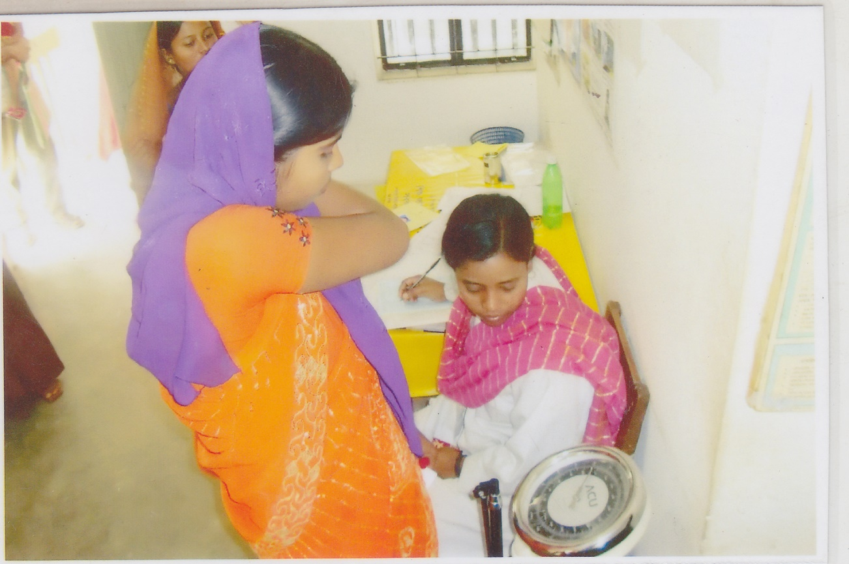
Registration & weight recoding by volunteers

Slide 31
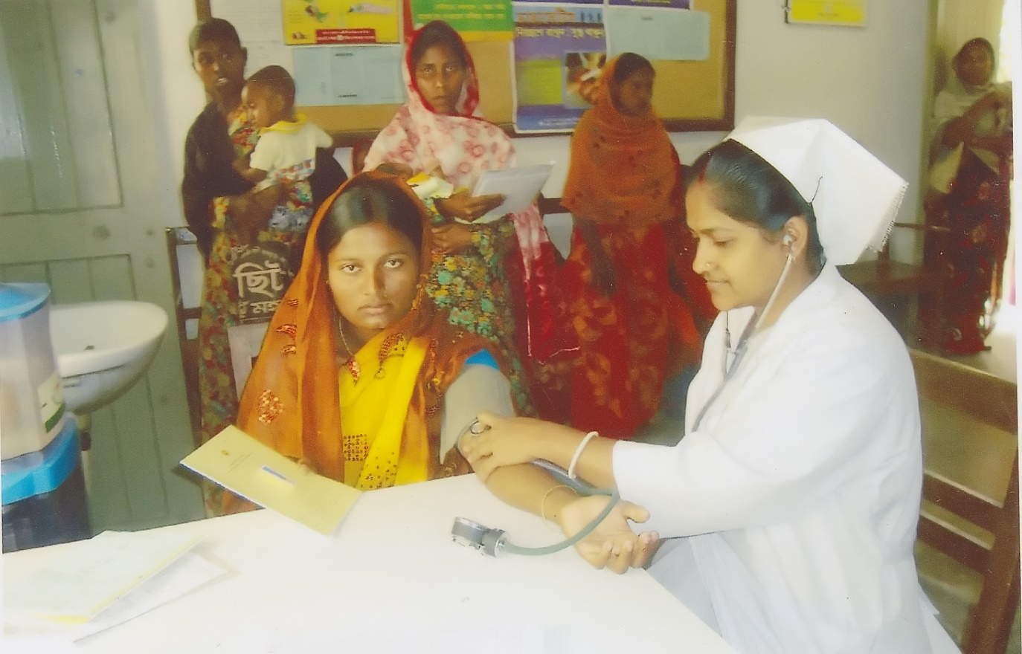
Blood presser is recorded by S.S.N

Slide 32
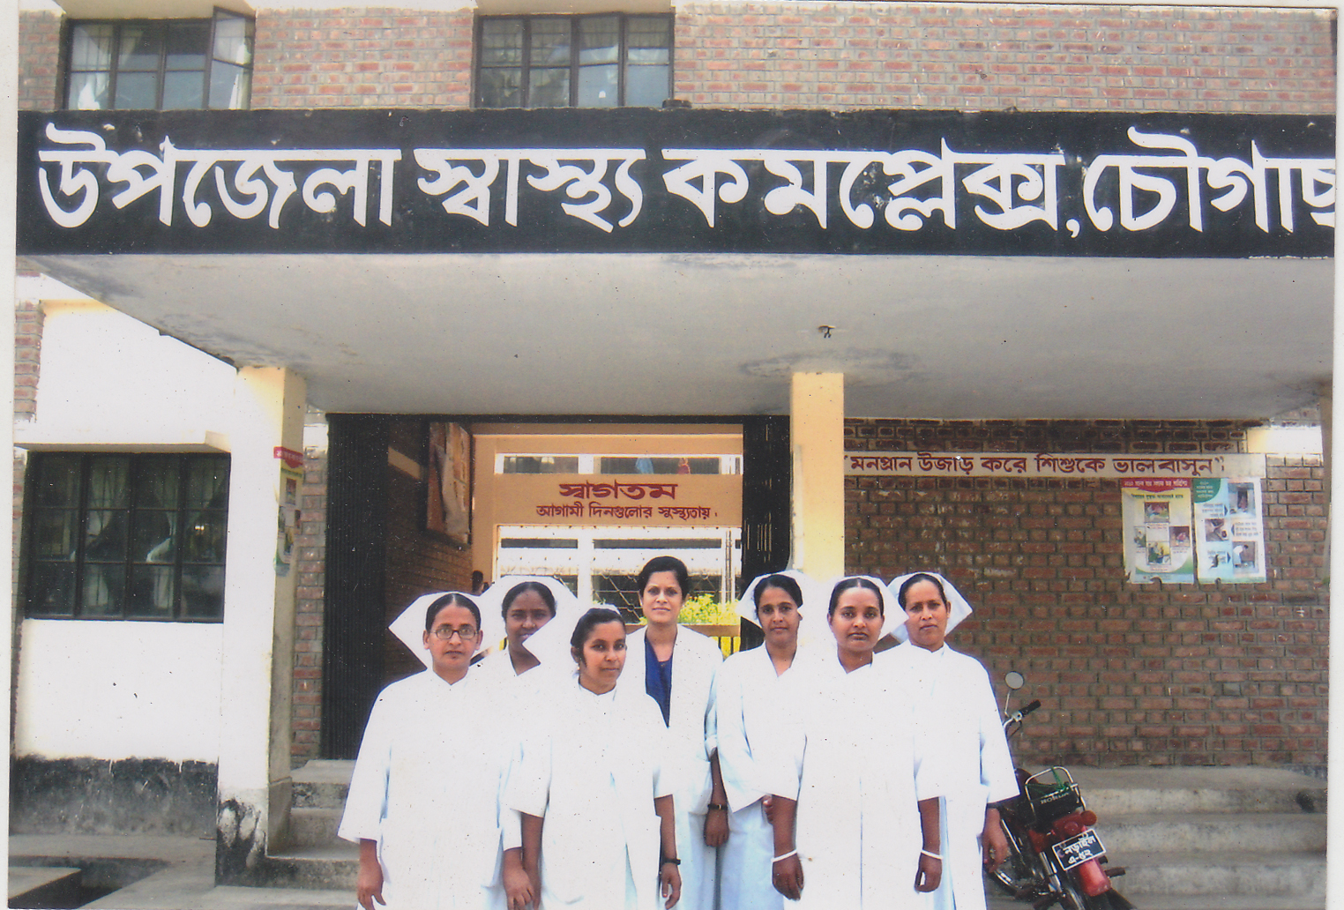
Dr. Salina and nurses who working in ANC corner & labour word.

Slide 33
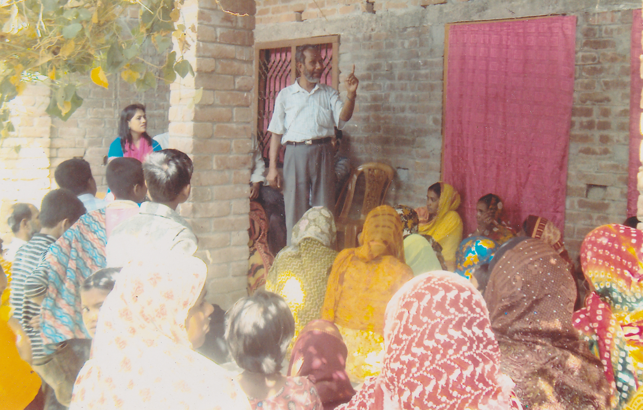
Health Education in Uthan Boithok in a rural village.

Slide 34
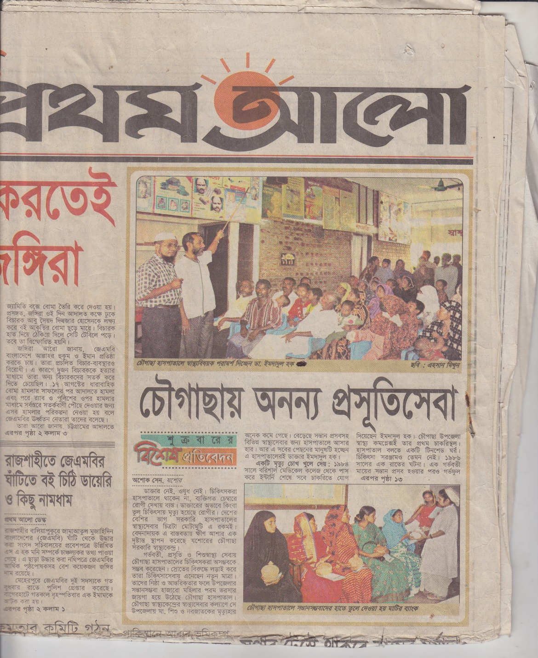
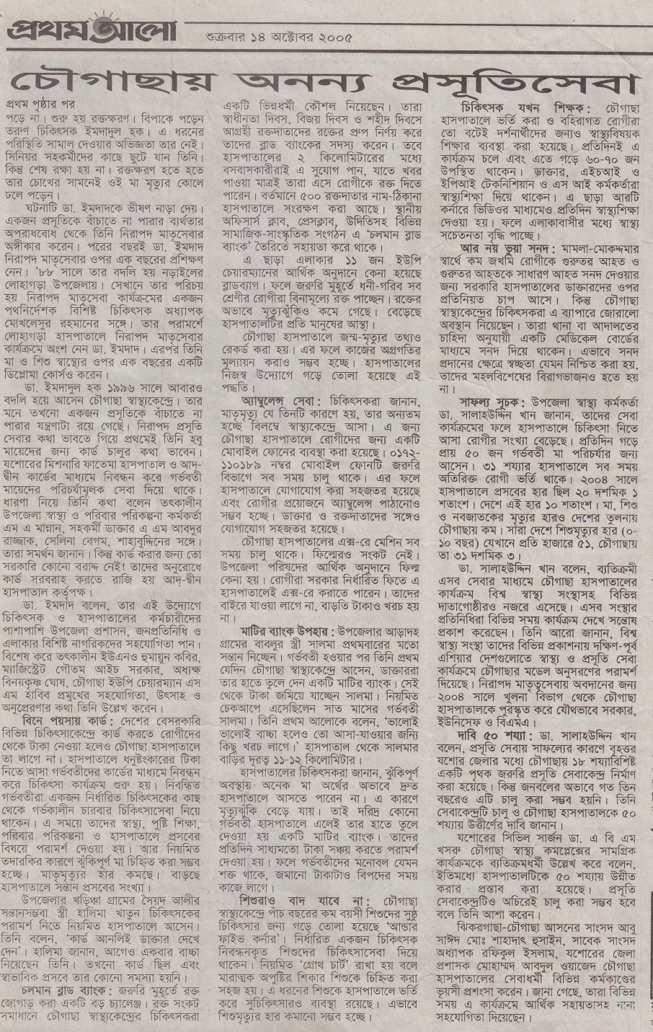

Slide 35
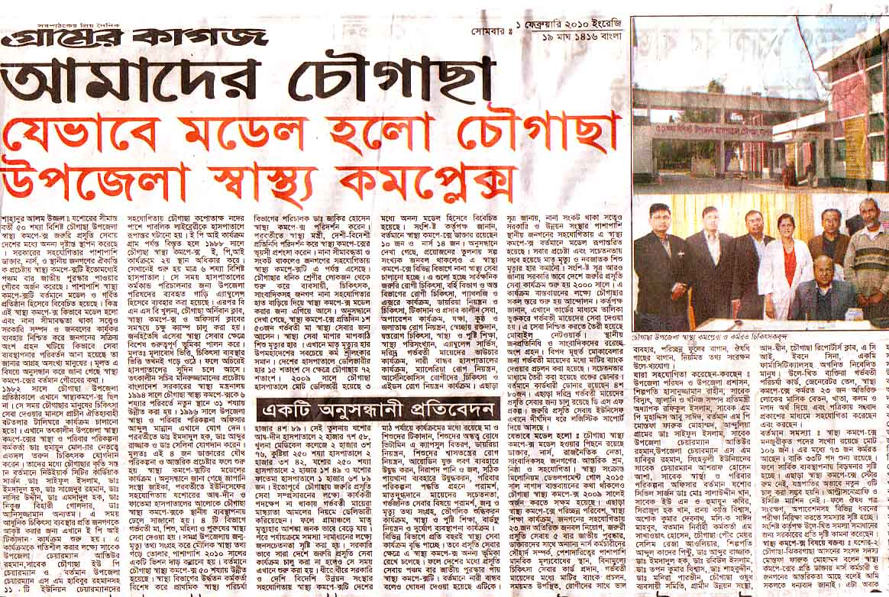
News of paper

Slide 36
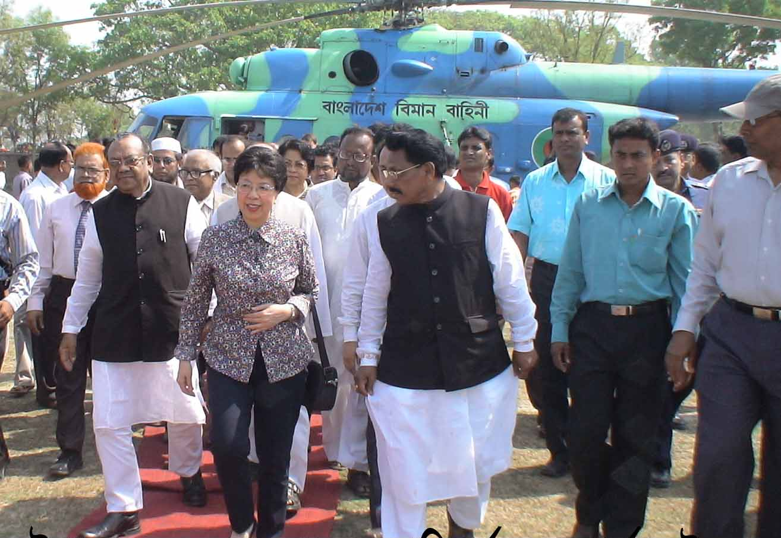
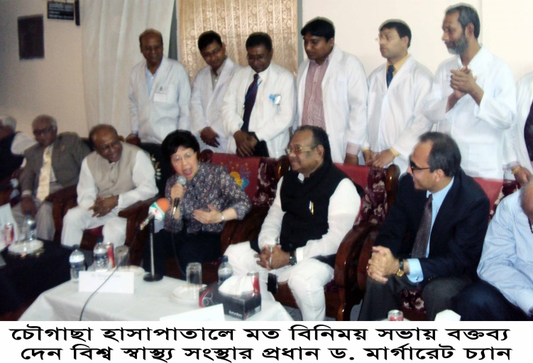
Òevsjv‡`‡ki Rb¨ ewnt we‡k¦i
†Kvb g‡W‡ji cÖ‡qvRb †bB|
†PŠMvQv g‡WjB h‡_ó ,
†PŠMvQv ¯^v¯’¨ †mevq `w¶Y
c~e© Gwkqv‡Z GKwU `„óvšÍ ¯’vcb K‡i‡Q|Ó
†PŠMvQv g‡Wj nvmcvZvj cwi`k©bKv‡j
W. gvM©v‡iU P¨vb (gnvcwiPvjK, wek¦ ¯^v¯’¨ ms¯’v)

Slide 37

Thank you

